Slide 1
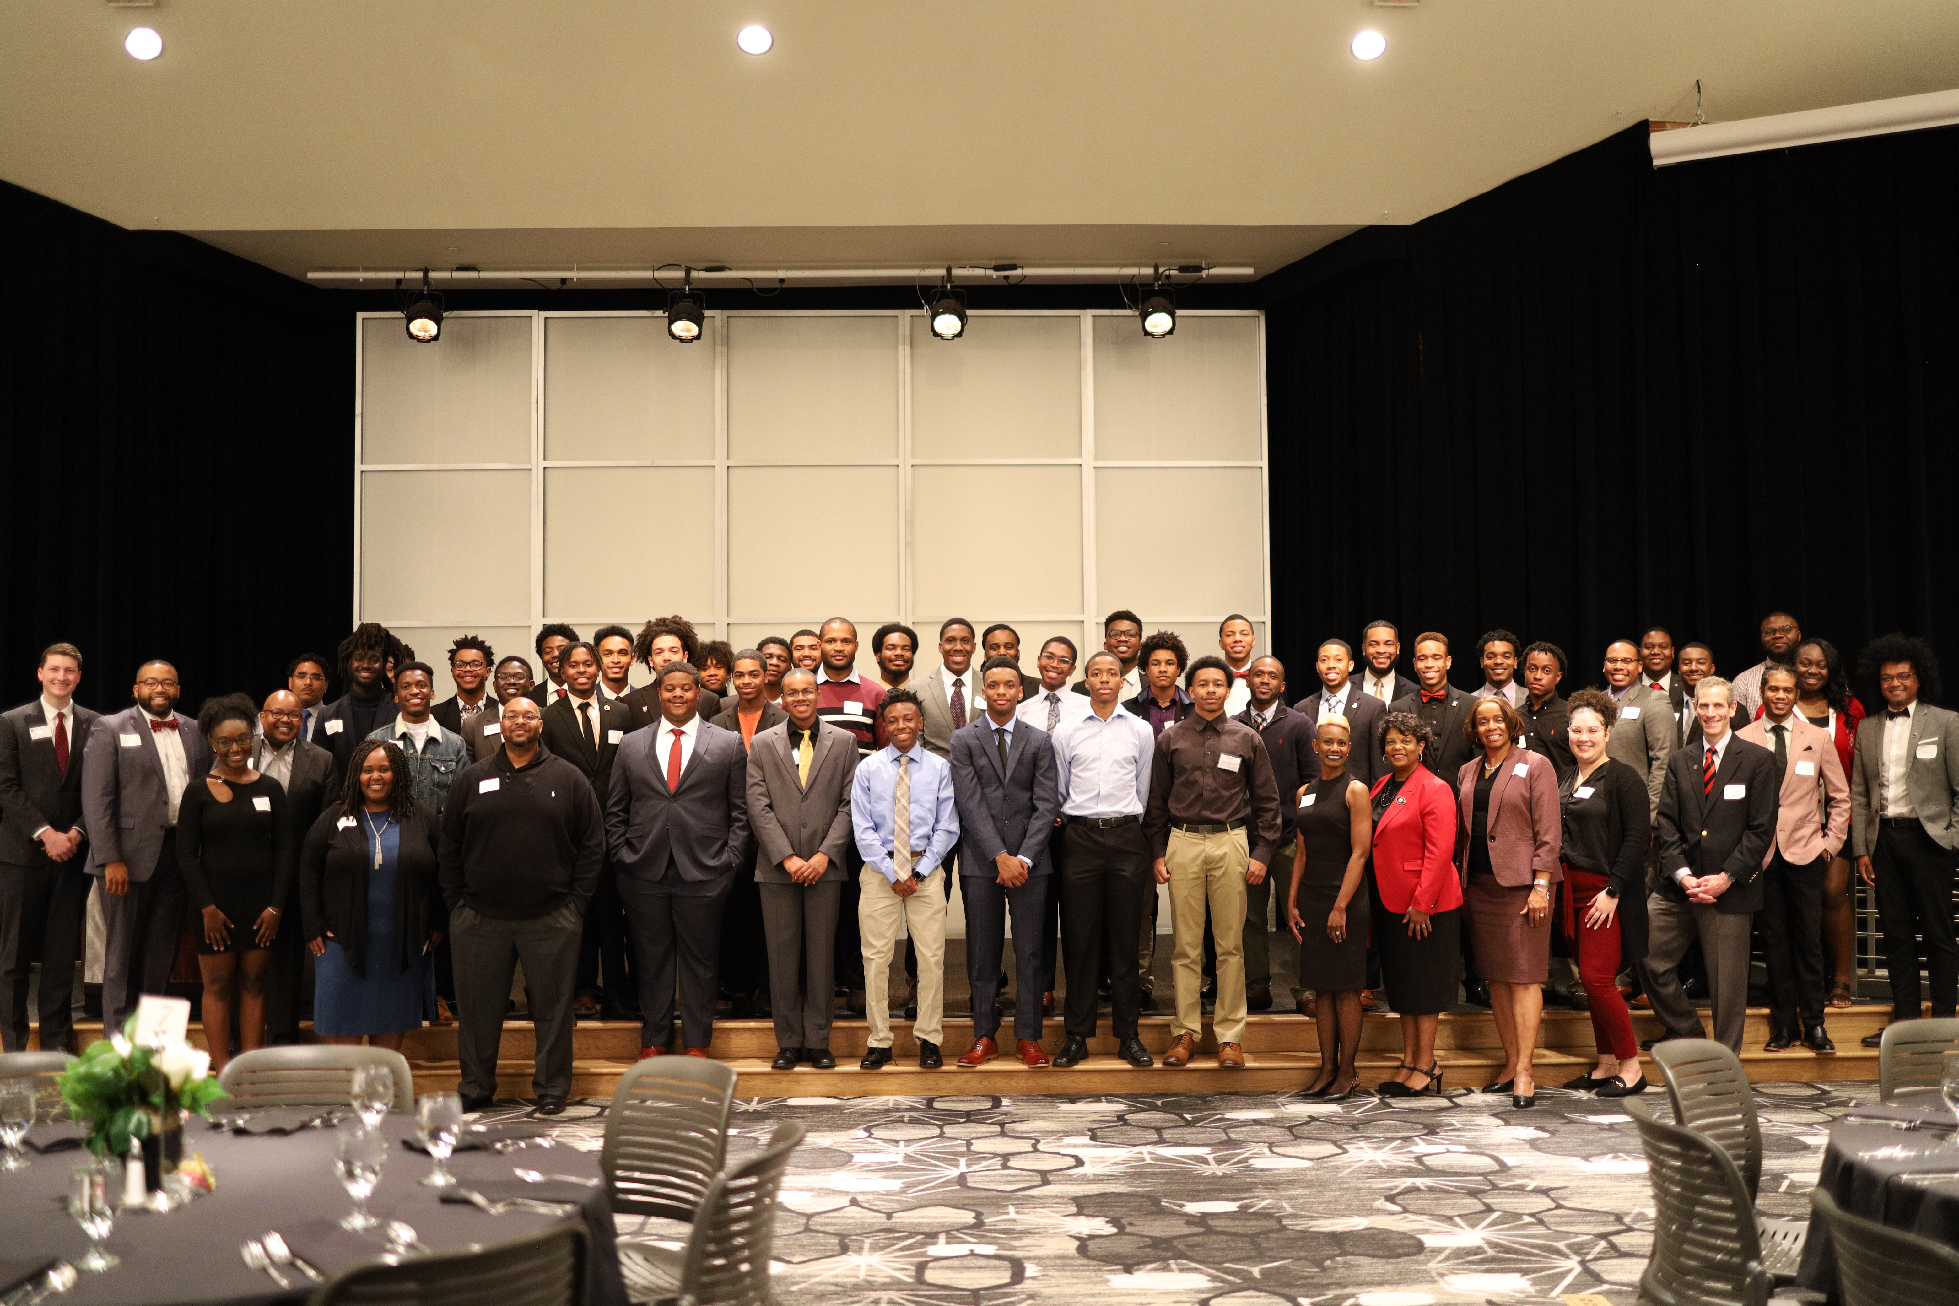


We Are GAAME

Slide 2
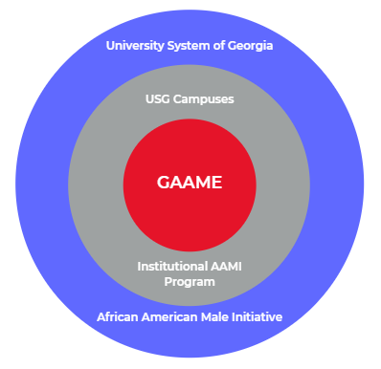



What is GAAME?
University System of Georgia
USG Campuses
GAAME
Institutional AAMI
Program
African American Male Initiative

Slide 3
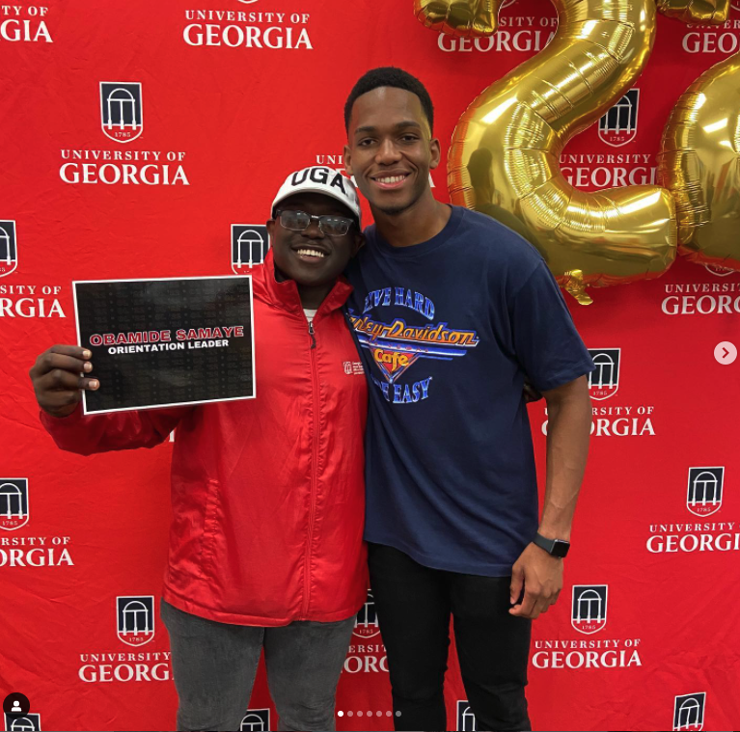
AAMI @ UGA
Established in 2014
Starts prior to enrollment
Capacity of roughly 100
Scholars language
Institutional Diversity Lead
Supported across campus

Slide 4
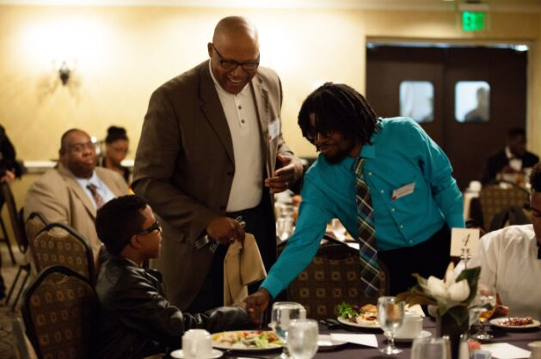
USG African American Male Initiative
The University System of Georgia’s (USG) African-American Male Initiative (AAMI®) is a statewide initiative designed to increase the number of African-American males who complete their postsecondary education from any of the USG institutions. Its mission is to provide an integrated program model of academic and social tools that support students around adopting a positive mindset to successfully complete classes, elevate their cumulative GPAs, matriculate through each academic level and graduate.

Slide 5
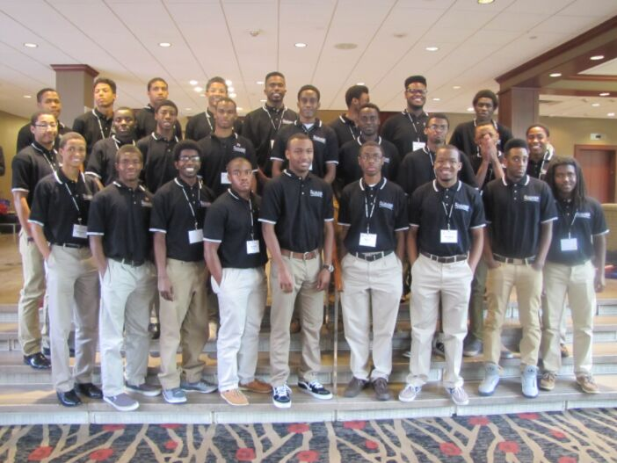
USG AAMI 2.0
In 2018, the USG’s AAMI began a new phase known as AAMI 2.0 with a stronger infrastructure, continuity in best practices, and strategic programming support. We are committed to significantly increase the graduation rates and the number of degrees conferred upon African-American males in the USG, blending our focus with the USG’s Momentum Year.
This will be achieved through the implementation of customized programming that is aligned with the AAMI Integrated Program Model. The model includes four key components:
  Academic Skills Enrichment: Provides supplemental literacy, writing, math and study-skill activities to help pre-college students transition to college academic life during the summer and assist enrolled AAMI participants with RPG (retention, progression, and graduation) throughout the academic year.
  Student Support Services: Makes available internal and external resources, information and learning tools to enhance students’ academic and social successes.
  Adult & Peer Mentoring: Connects AAMI students to adults and peers who encourage achievement, foster positive attitudes, as well as a sense of belonging through personal and academic support, while reinforcing RPG.
  Leadership Development: Provides multi-faceted professional and soft skills forums to help develop and strengthen participants’ leadership skills.

Slide 6
UGA's Georgia African American Male Experience (GAAME) Program
The GAAME program is a holistic approach to supporting African American male students throughout their matriculation at the University of Georgia. This approach includes a transition program, tutoring, academic coaching, leadership development, mentoring, grade monitoring, and exposure to campus resources. Collectively, these goals and objectives will push our program forward in the effort to achieve our desired program outcomes.
Goal 1: Assist African American male students in their transition and acclimation to the University of Georgia.
Goal 2: Support African Americans male students academically and socially throughout their enrollment at the University of Georgia.
Goal 3: Connect African American male students to leadership, career, and outreach opportunities available through the University of Georgia and our community partners.
Goal 4: Contribute to the safety and wellbeing of participants throughout their enrollment at the University of Georgia.

Slide 7
UGA's Georgia African American Male Experience (GAAME) Program
GAAME WEEKEND
GAAME AMBASSADORS
GAAME SCHOLARS
GAAME Weekend is a transition program for admitted African American male students, focusing on leadership and leadership development. During this weekend, admitted students meet with distinguished faculty, prominent alumni, and leading members of the student body. Students also participate in various extracurricular activities that the University has to offer.
GAAME Ambassadors are representatives between the program and our student body. This group of engaged African American men assist in the planning and implementation of programming, serve as peer mentors, and as support efforts related to the academic and social support of African American male students. Ambassadors gain vital leadership experience, communication skills, and professional development training through their participation.
The GAAME Scholars program provides additional support to undergraduate African American male students who are looking to enhance their undergraduate experience by engaging in a program specifically designed to support and affirm their identities.

Slide 8
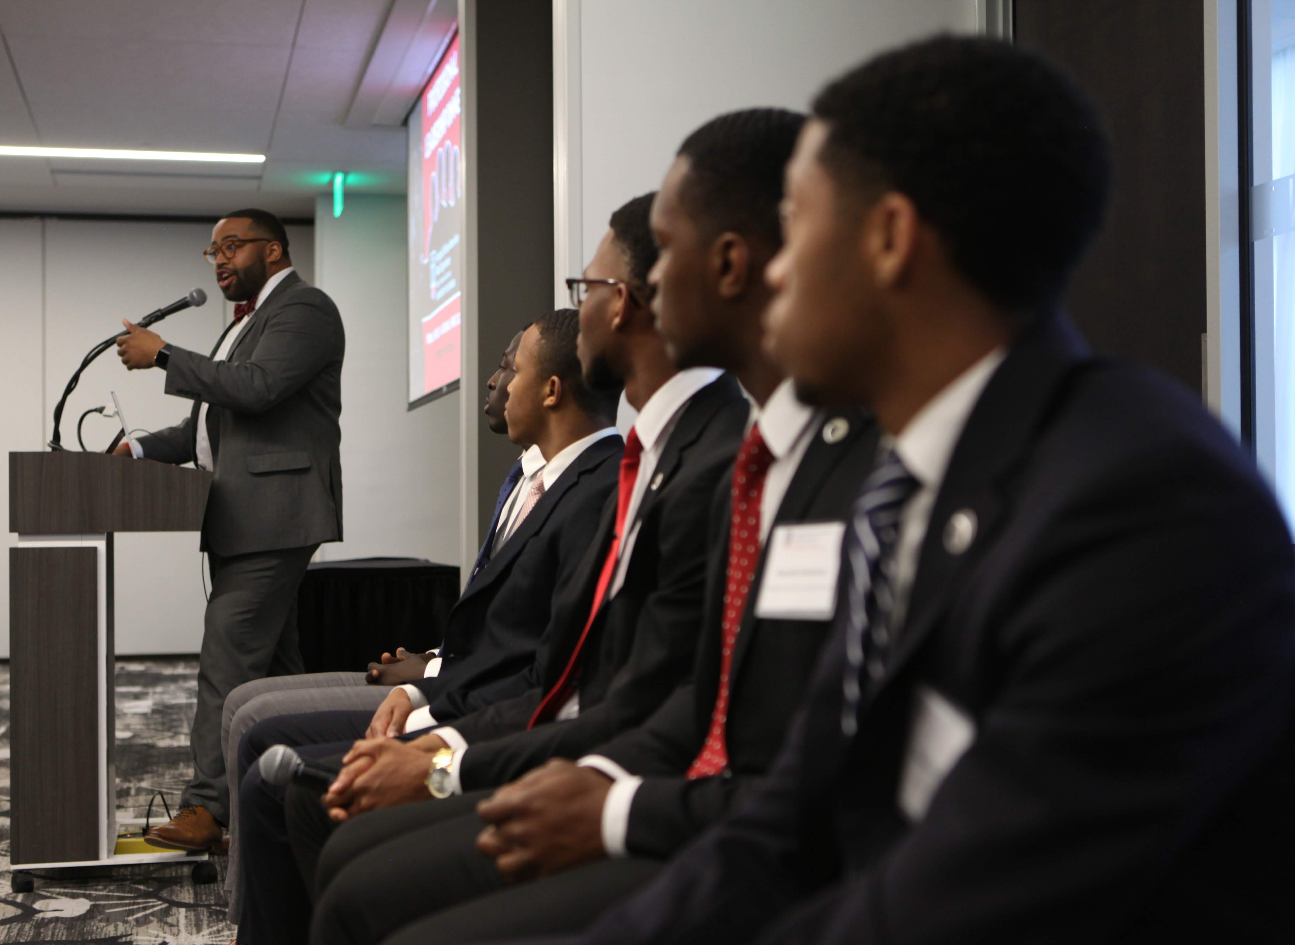
GAAME Scholars Program

Slide 9
UGA's Georgia African American Male Experience (GAAME) Scholars Program
GAAME Scholars
First-Year Fellows
Ambassadors
General Scholars
GAAME Affiliates

Slide 10
UGA's Georgia African American Male Experience (GAAME) Scholars Program
GAAME SCHOLARS
GAAME AFFILIATES
The GAAME Scholars are active members of the GAAME program, as either First-Year Fellows, Ambassadors, or General Scholars. Based on their academic year, requirements for remain eligible differ.
GAAME Affiliates are students who were former scholars, attended GAAME Weekend, or are referred to our program from campus partners. These individuals are supported by a member of the staff but are not eligible for benefits that come with being a Scholar.

Slide 11


GAAME Scholars
PROGRAM BENEFITS
REQUIREMENTS
  Individualized academic coaching and guidance
  Professional and leadership development support
  Access to experiential learning funding
  Enhanced peer mentorship & engagement
  Exclusive alumni, peer, and professional networking opportunities
  Access to Tutor.com and GAAME Bachelor Prep Library
  Submit GAAME Scholar application
  Meet with GAAME staff semesterly
  Fulfill at least two activities on the GAAME Points of Participation Model
COMMIT
CONNECT
ENGAGE

Slide 12
GAAME Scholars
GENERAL SCHOLARS
FIRST-YEAR FELLOWS
GAAME AMBASSADORS
The GAAME Scholars program provides additional support to undergraduate African American male students who are looking to enhance their undergraduate experience by engaging in a program specifically designed to support and affirm their identities.
To expand upon the program's impact and ability to foster community throughout their first year at UGA, we are excited to offer the GAAME First-Year Fellows Program. Thanks to funding from an alumni donor, 20 first-year GAAME Scholars will begin their UGA journey utilizing a cohort model. These GAAME First-Year Fellows will experience strategic programming cultivated to ease their transition into UGA, fostering strong relationships with their peers, program staff, as well as key members of the institutional community.
GAAME Ambassadors are representatives between the program and our student body. This group of engaged African American men assist in the planning and implementation of programming, serve as peer mentors, and as support efforts related to the academic and social support of African American male students. Ambassadors gain vital leadership experience, communication skills, and professional development training through their participation.

Slide 13


Slide 15
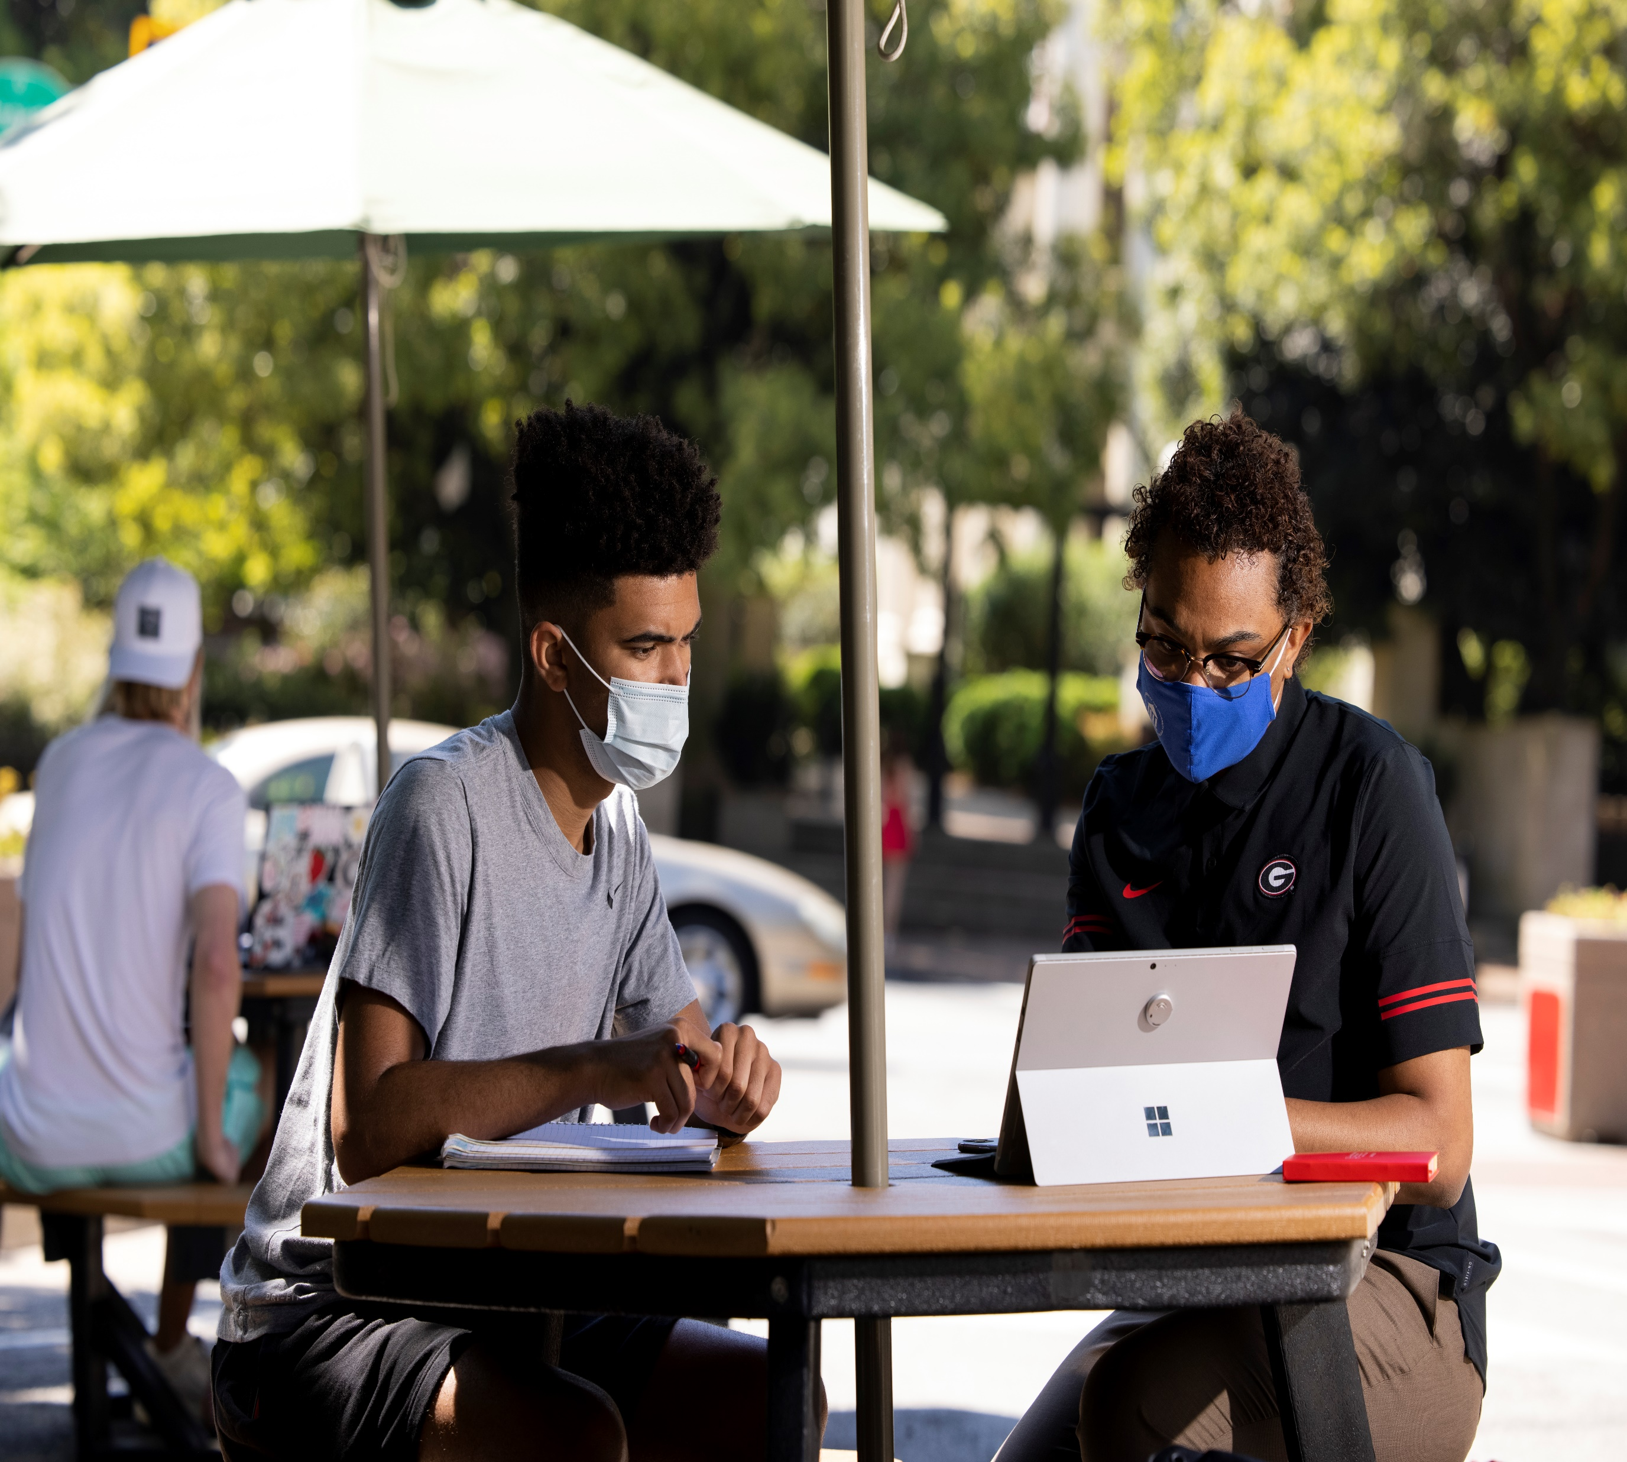
Strategic Partnerships

Slide 16

Exploratory Center
The Partnership Includes:
Spring Yield Program Session
Fall Introductory Email
Mid-Semester Intervention
Advising and Follow-up
Membership on Advisory Board

Slide 17
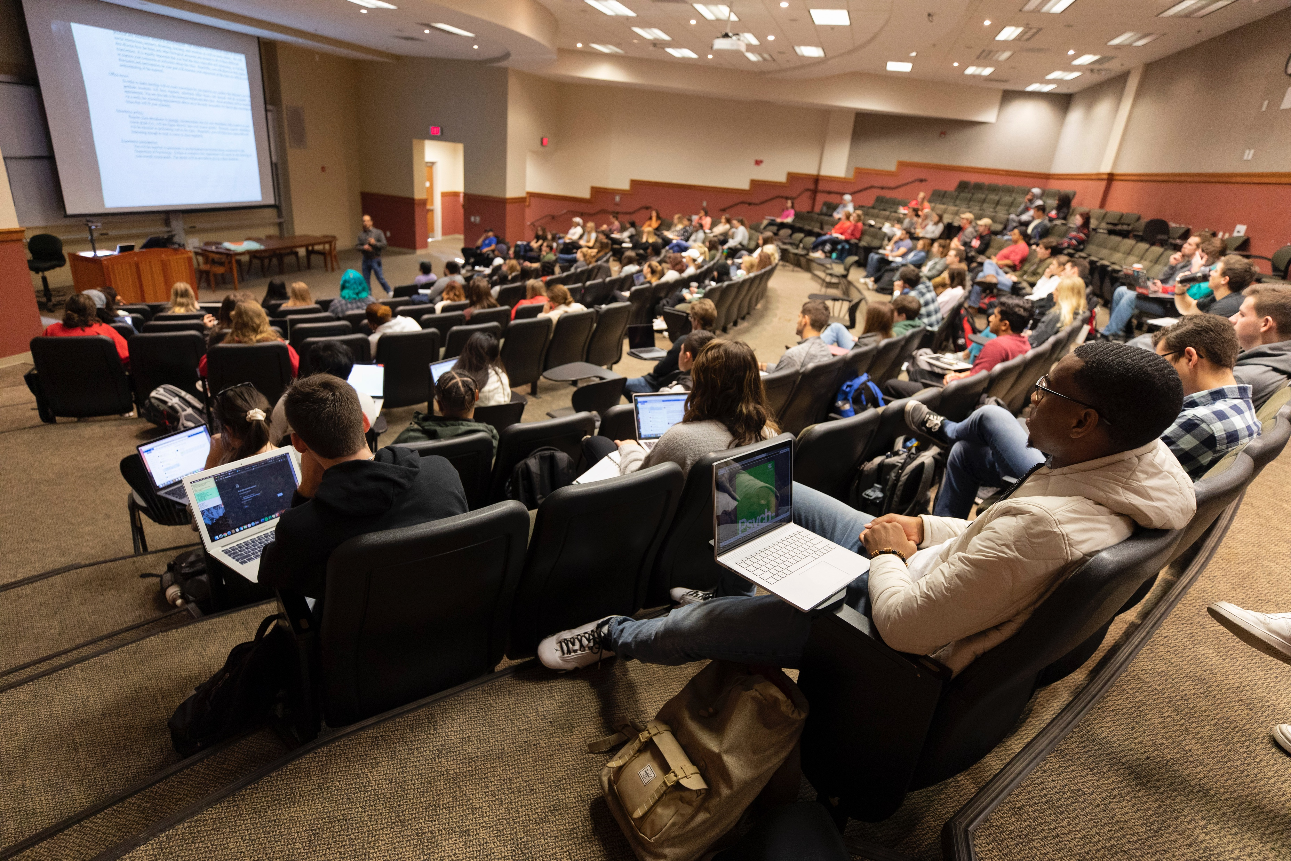
Academic Advising Services
The Partnership Includes:
Supplemental academic advising support
Mid-Semester Intervention
Resource guidance

Slide 18
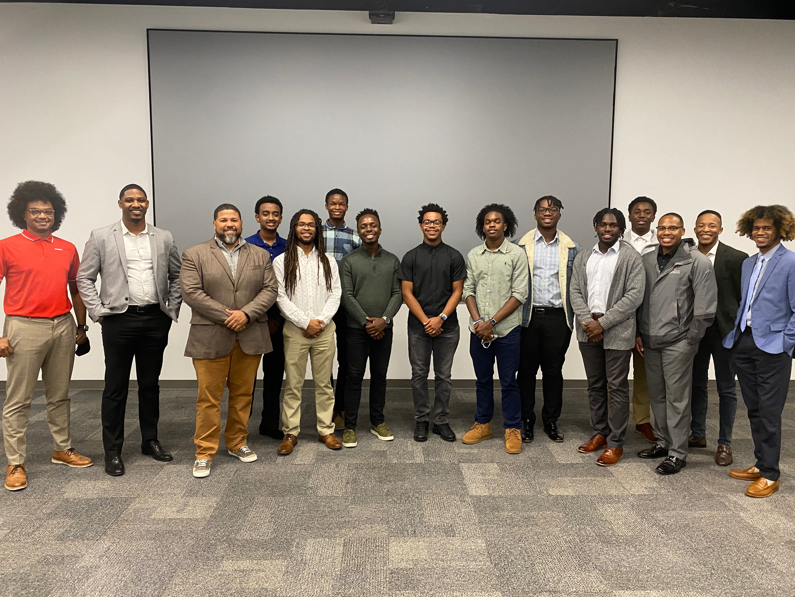
Division of Academic Enhancement
The Partnership Includes:
UNIV Courses for first-year, transfer,
and upper-class students

Slide 19

Through this partnership we anticipate that participants will benefit from:
Virtual career day
Career Pipeline Program
Connecting students to internships
Scholarship opportunities
On-campus engagement with both the 100 Black Men and Emerging 100 Members
Mentorship with 100 Black Men and Emerging 100 Members

Slide 20
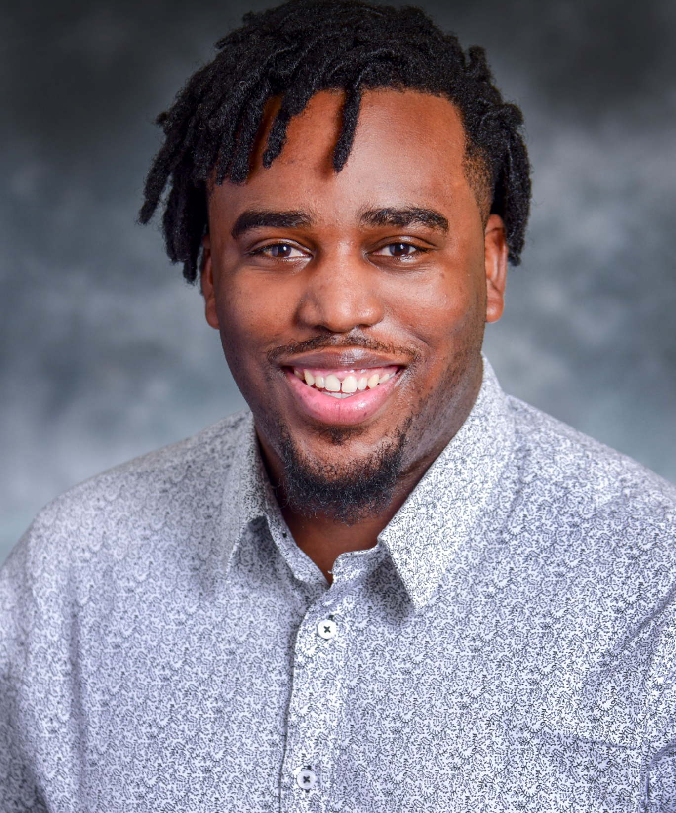
Mental Health & Wellbeing Support
Dr. Jesmond A. Fair
Clinical Psychologist
South Fulton County VA Clinic
Dr. Jesmond Fair is a University of Georgia Double Dawg and University of Alabama Alumnus from Opelika, AL. He currently serves as a clinical psychologist for the Atlanta VA and has a passion for the LGBTQ+, Black, and underserved communities.

Slide 21
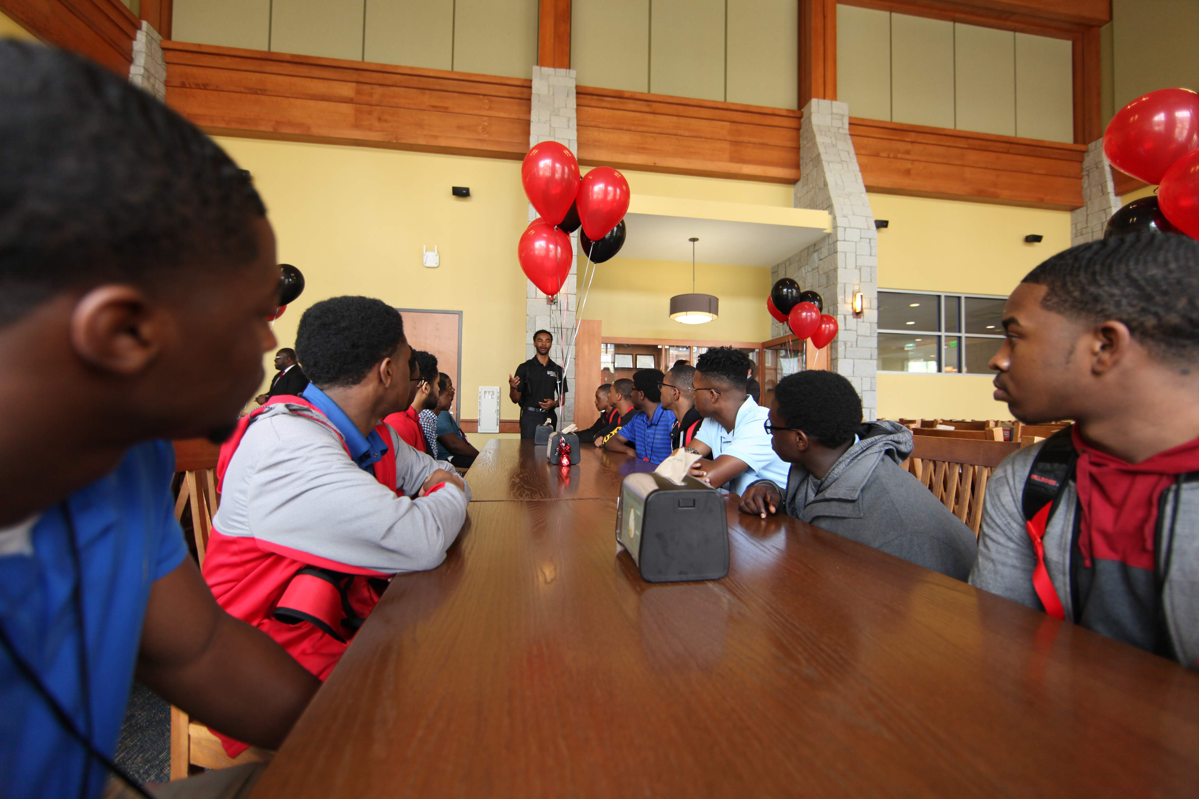
Upcoming Events
TBA

Slide 22


Slide 23
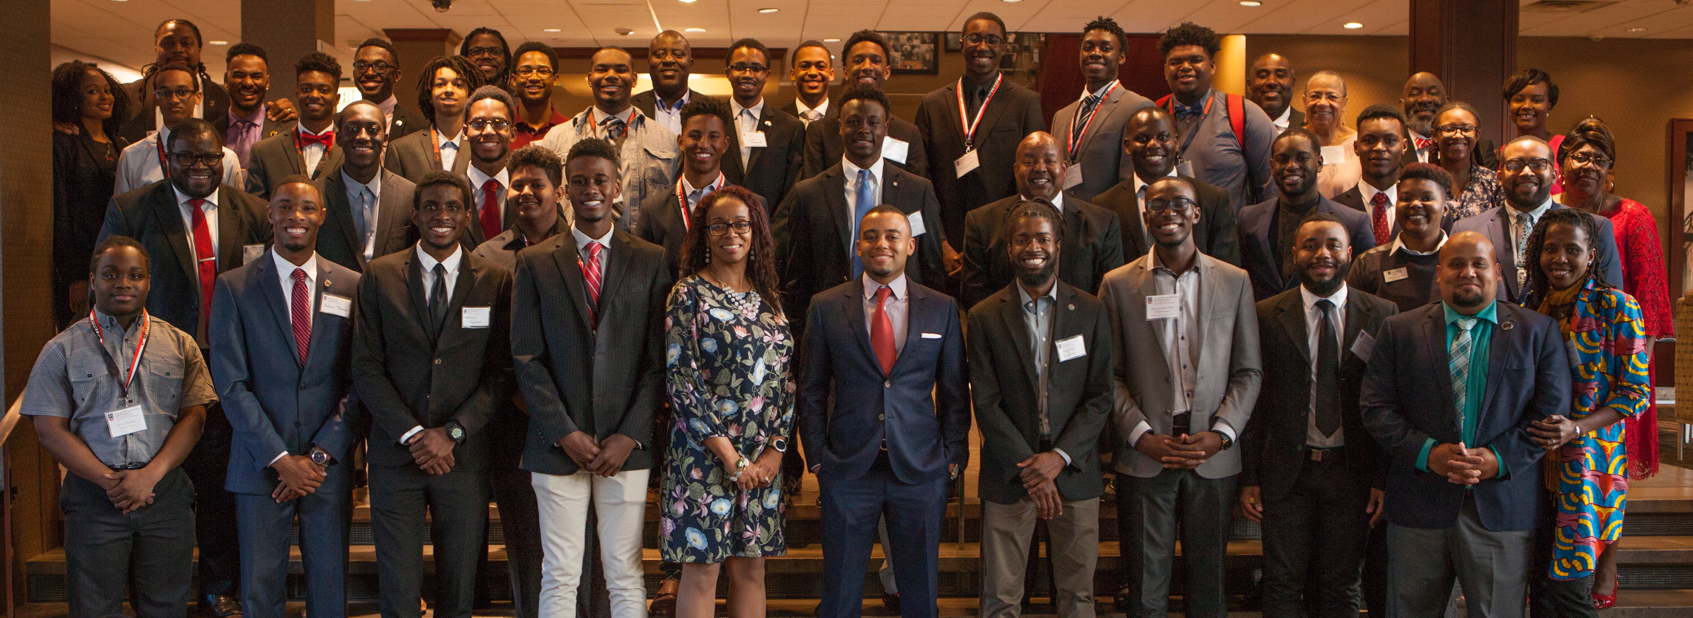
GAAME Weekend
Parent Orientation Faculty Lecture Lunch with the President
Ice Breakers Student Panel Intended Major Campus Visit
Leadership Dinner GAAME Night Lunch with Student Leaders
Graduate Student Pane Leadership Workshop Academic Opportunities Fair

Slide 24
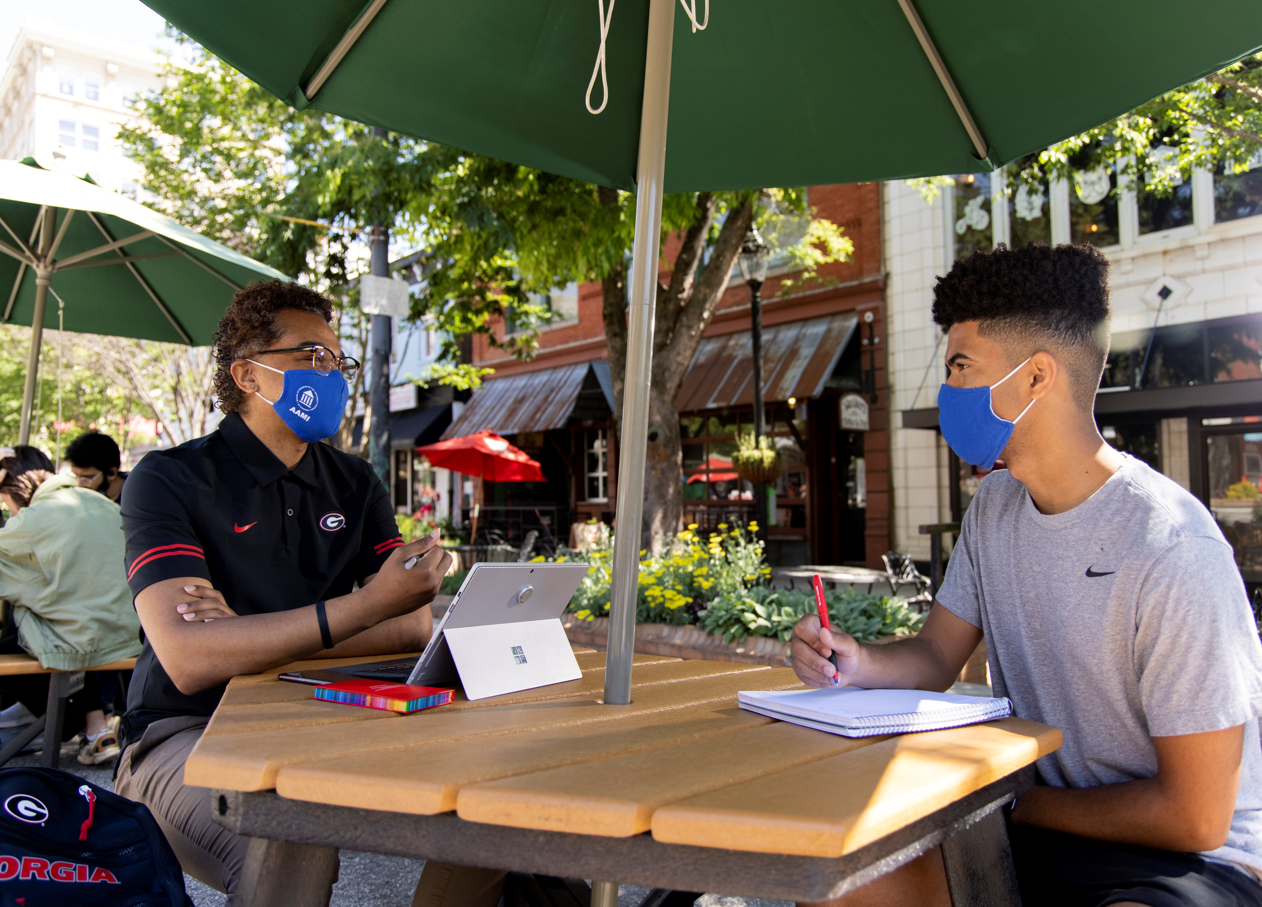
Contact Us

Slide 25
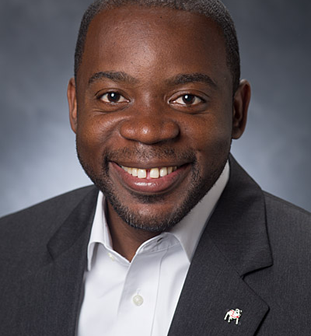
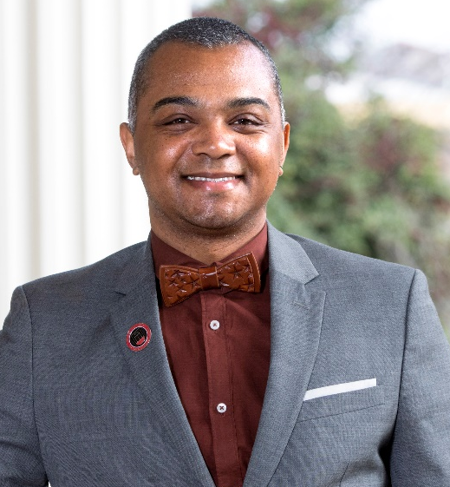
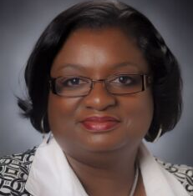
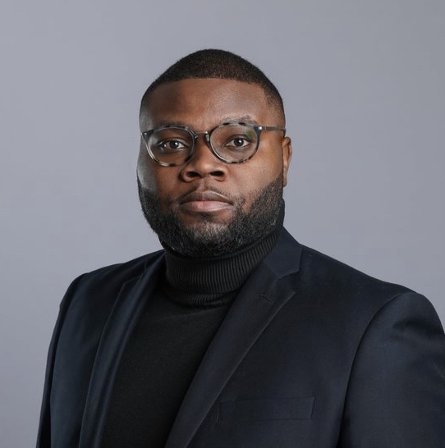
GAAME Staff
L. Randolph Carter
MARQUES R. DEXTER
Co-Director
Co-Director
lrcarter@uga.edu
mrdst3@uga.edu
JOAN PITTMAN
Robert Wright
Budget Manager
Program Coordinator
jpitt@uga.edu
Robert.wright2@uga.edu
Office of Institutional Diversity
210 Holmes-Hunter Academic Building
Athens, GA 30602
P: 706-583-8195
F: 706-583-8199
http://diversity.uga.edu

Slide 26


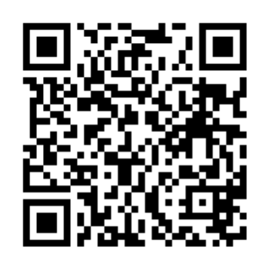
Are You GAAME?
GAAME Website
GAAME Scholars Application Form
GAAME Email
http://bit.ly/2UGA_GAAME
http://bit.ly/GAAMEScholarUGA
GAAME@uga.edu
GAAME Scholars Interest Form

