Slide 1
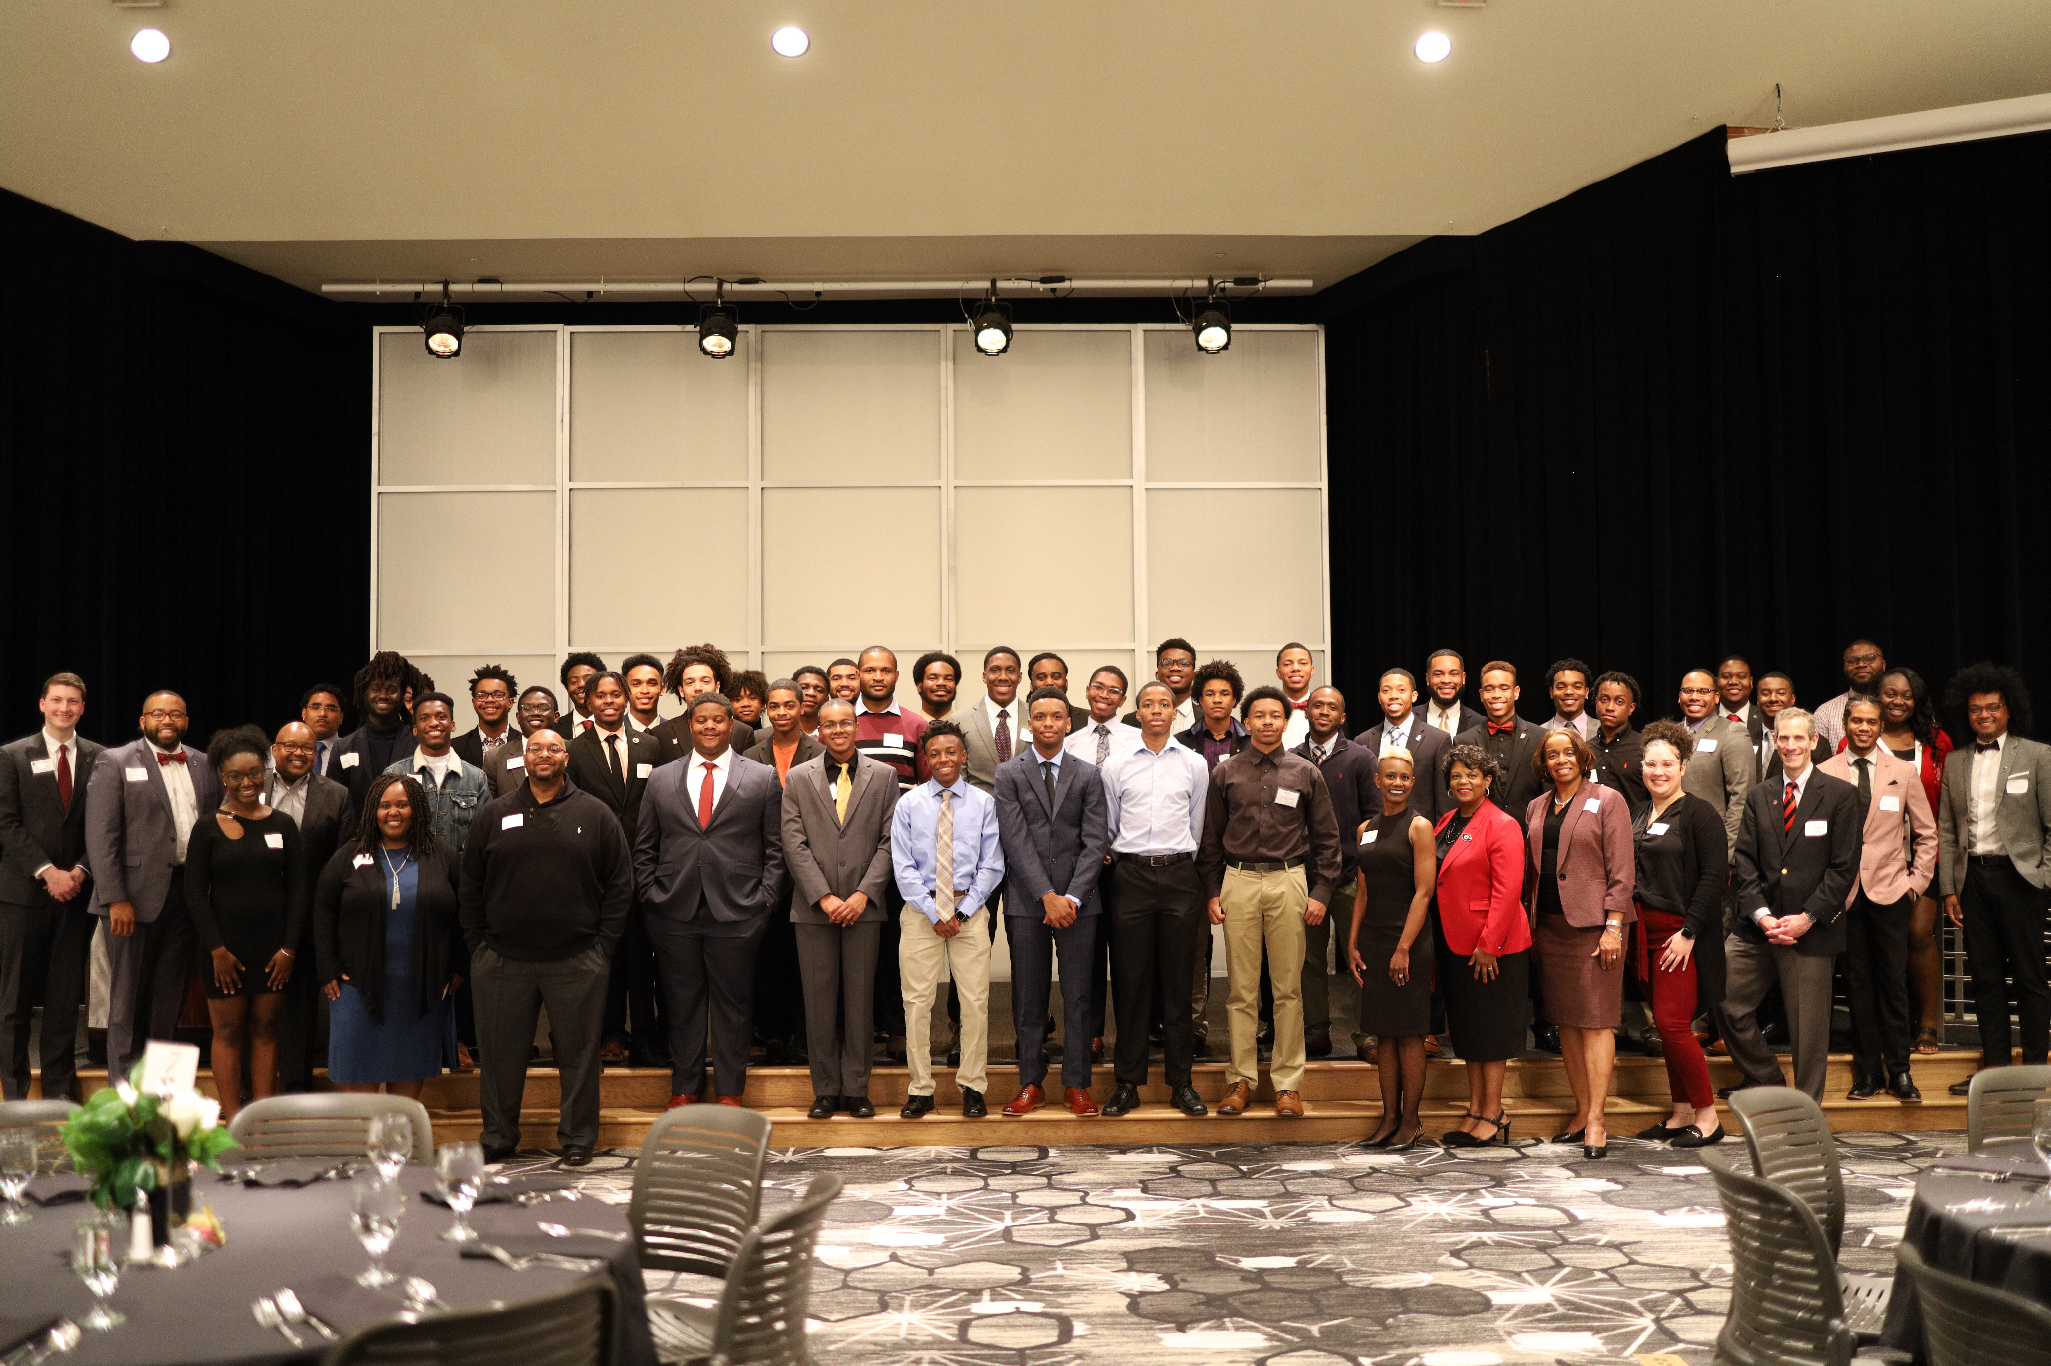


We Are GAAME

Slide 2
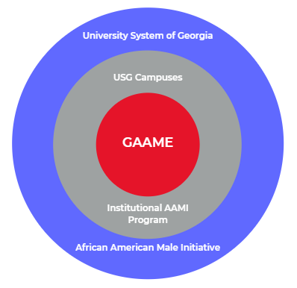



What is GAAME?
University System of Georgia
USG Campuses
GAAME
Institutional AAMI
Program
African American Male Initiative

Slide 3

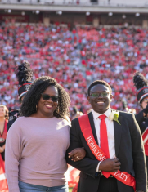
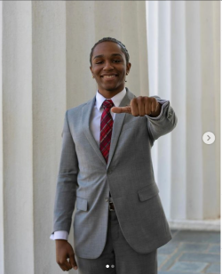
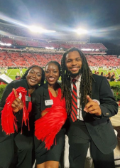
What is GAAME?
Who
University System of Georgia
USG Campuses
GAAME
Institutional AAMI
Program
Oba Samaye,
Student Government
Kellan Frenelle,
Red Coats
Matthew Turnipseed,
Orientation Leader
William Redding,
Arch Society
African American Male Initiative
We Are GAAME

Slide 4
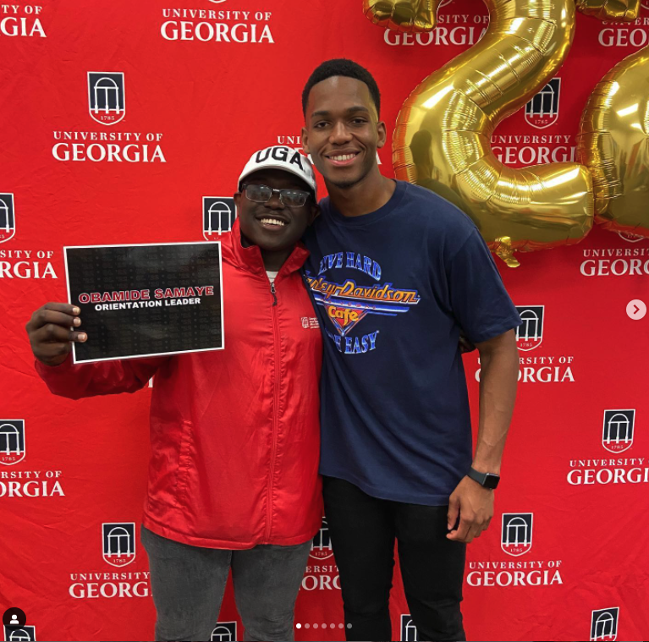
AAMI @ UGA
Established in 2014
Starts Prior to Enrollment
Capacity of Approx. 75
Scholars Language
OIE Lead w/ Admin & Campus Support

Slide 5
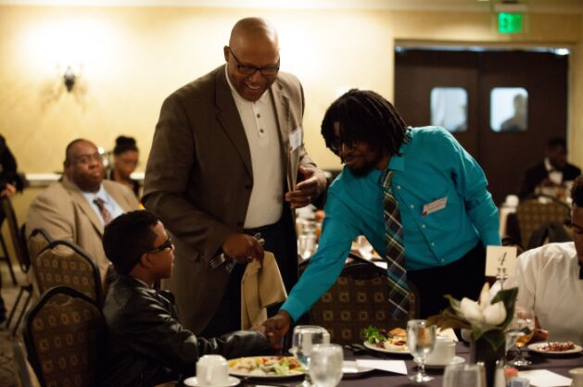
USG African American Male Initiative
The University System of Georgia’s (USG) African-American Male Initiative (AAMI®) is a statewide initiative designed to increase the number of African-American males who complete their postsecondary education from any of the USG institutions. Its mission is to provide an integrated program model of academic and social tools that support students around adopting a positive mindset to successfully complete classes, elevate their cumulative GPAs, matriculate through each academic level and graduate.

Slide 6
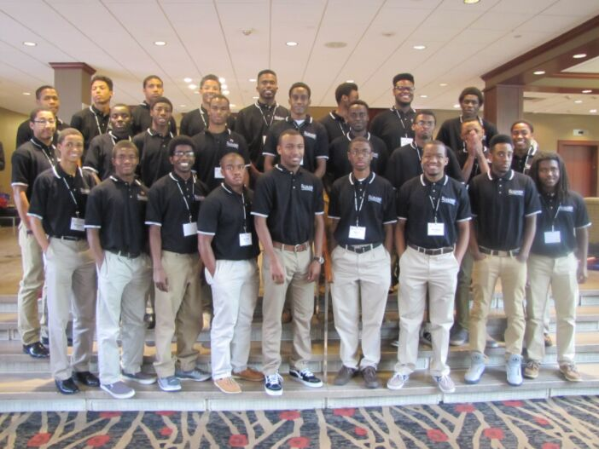
USG AAMI 2.0
In 2018, the USG’s AAMI began a new phase known as AAMI 2.0 with a stronger infrastructure, continuity in best practices, and strategic programming support. We are committed to significantly increase the graduation rates and the number of degrees conferred upon African-American males in the USG, blending our focus with the USG’s Momentum Year.
This will be achieved through the implementation of customized programming that is aligned with the AAMI Integrated Program Model. The model includes four key components:
  Academic Skills Enrichment: Provides supplemental literacy, writing, math and study-skill activities to help pre-college students transition to college academic life during the summer and assist enrolled AAMI participants with RPG (retention, progression, and graduation) throughout the academic year.
  Student Support Services: Makes available internal and external resources, information and learning tools to enhance students’ academic and social successes.
  Adult & Peer Mentoring: Connects AAMI students to adults and peers who encourage achievement, foster positive attitudes, as well as a sense of belonging through personal and academic support, while reinforcing RPG.
  Leadership Development: Provides multi-faceted professional and soft skills forums to help develop and strengthen participants’ leadership skills.

Slide 7
UGA's Georgia African American Male Experience (GAAME) Program
The GAAME program is a holistic approach to supporting African American male students throughout their matriculation at the University of Georgia. This approach includes a transition program, tutoring, academic coaching, leadership development, mentoring, grade monitoring, and exposure to campus resources. Collectively, these goals and objectives will push our program forward in the effort to achieve our desired program outcomes.
Goal 1: Assist African American male students in their transition and acclimation to the University of Georgia.
Goal 2: Support African Americans male students academically and socially throughout their enrollment at the University of Georgia.
Goal 3: Connect African American male students to leadership, career, and outreach opportunities available through the University of Georgia and our community partners.
Goal 4: Contribute to the safety and wellbeing of participants throughout their enrollment at the University of Georgia.

Slide 8
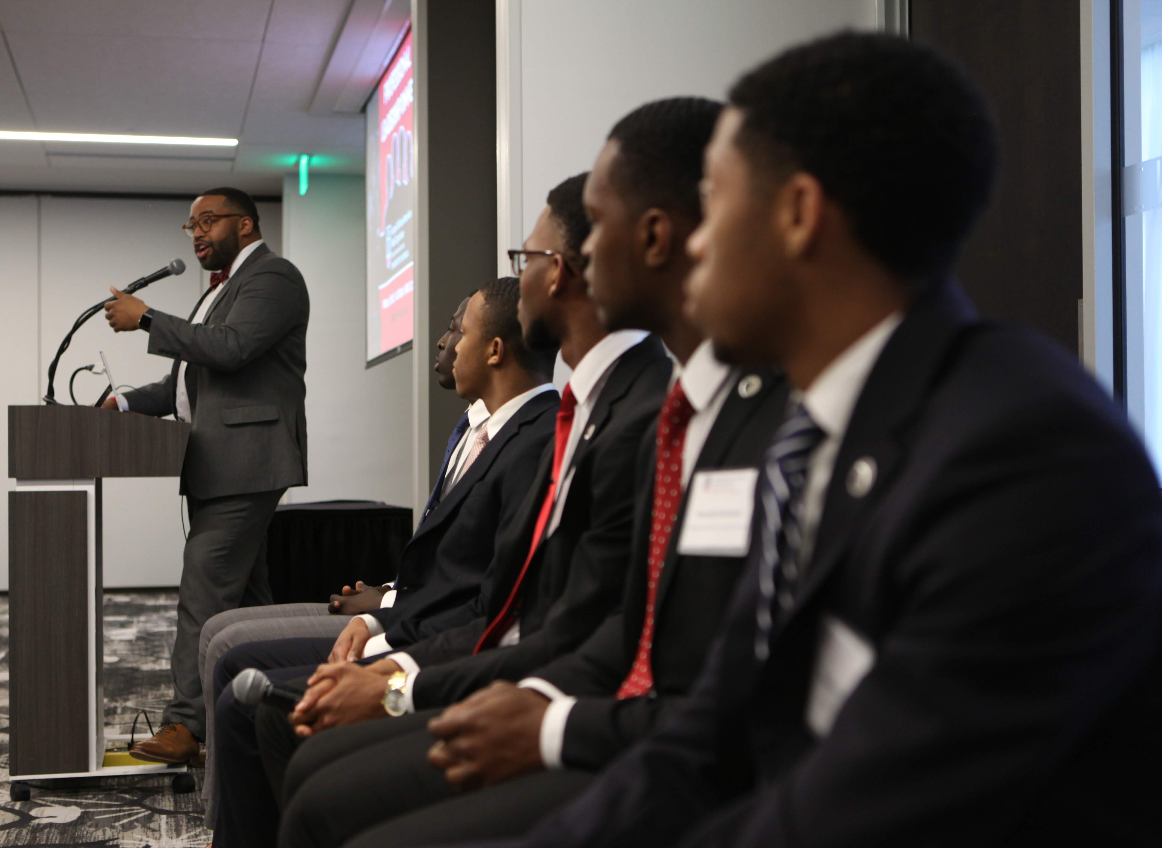
GAAME Scholars Program

Slide 9
UGA’s GAAME Scholars
GAAME @ Daze WEEKEND
GAAME AMBASSADORS
FIRST-YEAR FELLOWS
GAAME Weekend is the annual jump-start of the University’s African American Male Initiative, the GAAME Scholars program. Kicking off Thursday evening before the April Georgia Daze Weekend, attendees and their parents/guardians will engage with our GAAME Scholars, connect with Black Male Leadership Society members, and meet prominent UGA faculty, staff, administrators, and alumni over an engaging dinner. Afterward, students will stay with their Georgia Daze host in one of our campus residence halls, partaking in strategic programming over the next two days, highlighted by having lunch with UGA President, Jere W. Morehead on Friday.
GAAME Ambassadors are representatives between the program and our student body. This group of engaged African American men assist in the planning and implementation of programming, serve as peer mentors, and as support efforts related to the academic and social support of African American male students. Ambassadors gain vital leadership experience, communication skills, and professional development training through their participation.
To expand upon the program's impact and ability to foster community throughout their first year at UGA, we are excited to offer the GAAME First-Year Fellows Program. Thanks to funding from an alumni donor, 20 first-year GAAME Scholars will begin their UGA journey utilizing a cohort model. These GAAME First-Year Fellows will experience strategic programming cultivated to ease their transition into UGA, fostering strong relationships with their peers, program staff, as well as key members of the institutional community.

Slide 10
UGA’s GAAME Scholars
GAAME Scholars
First-Year Fellows
Ambassadors
General Scholars
GAAME Affiliates
GAAME SCHOLARS
GAAME AFFILIATES
The GAAME Scholars are active members of the GAAME program, as either First-Year Fellows, Ambassadors, or General Scholars. Based on their academic year, requirements for remain eligible differ.
GAAME Affiliates are students who were former scholars, attended GAAME Weekend, or are referred to our program from campus partners. These individuals are supported by a member of the staff but are not eligible for benefits that come with being a Scholar.

Slide 11


GAAME Scholars
PROGRAM BENEFITS
REQUIREMENTS
  Individualized academic coaching and guidance
  Professional and leadership development support
  Access to experiential learning support
  Enhanced peer mentorship & engagement
  Exclusive alumni, peer, and professional networking opportunities
  Access to GAAME Post-Bachelor Prep Library
  Submit GAAME Scholar application
  Meet with GAAME staff semesterly
  Fulfill at least two activities on the GAAME Points of Participation Model
COMMIT
CONNECT
ENGAGE

Slide 12


Slide 14
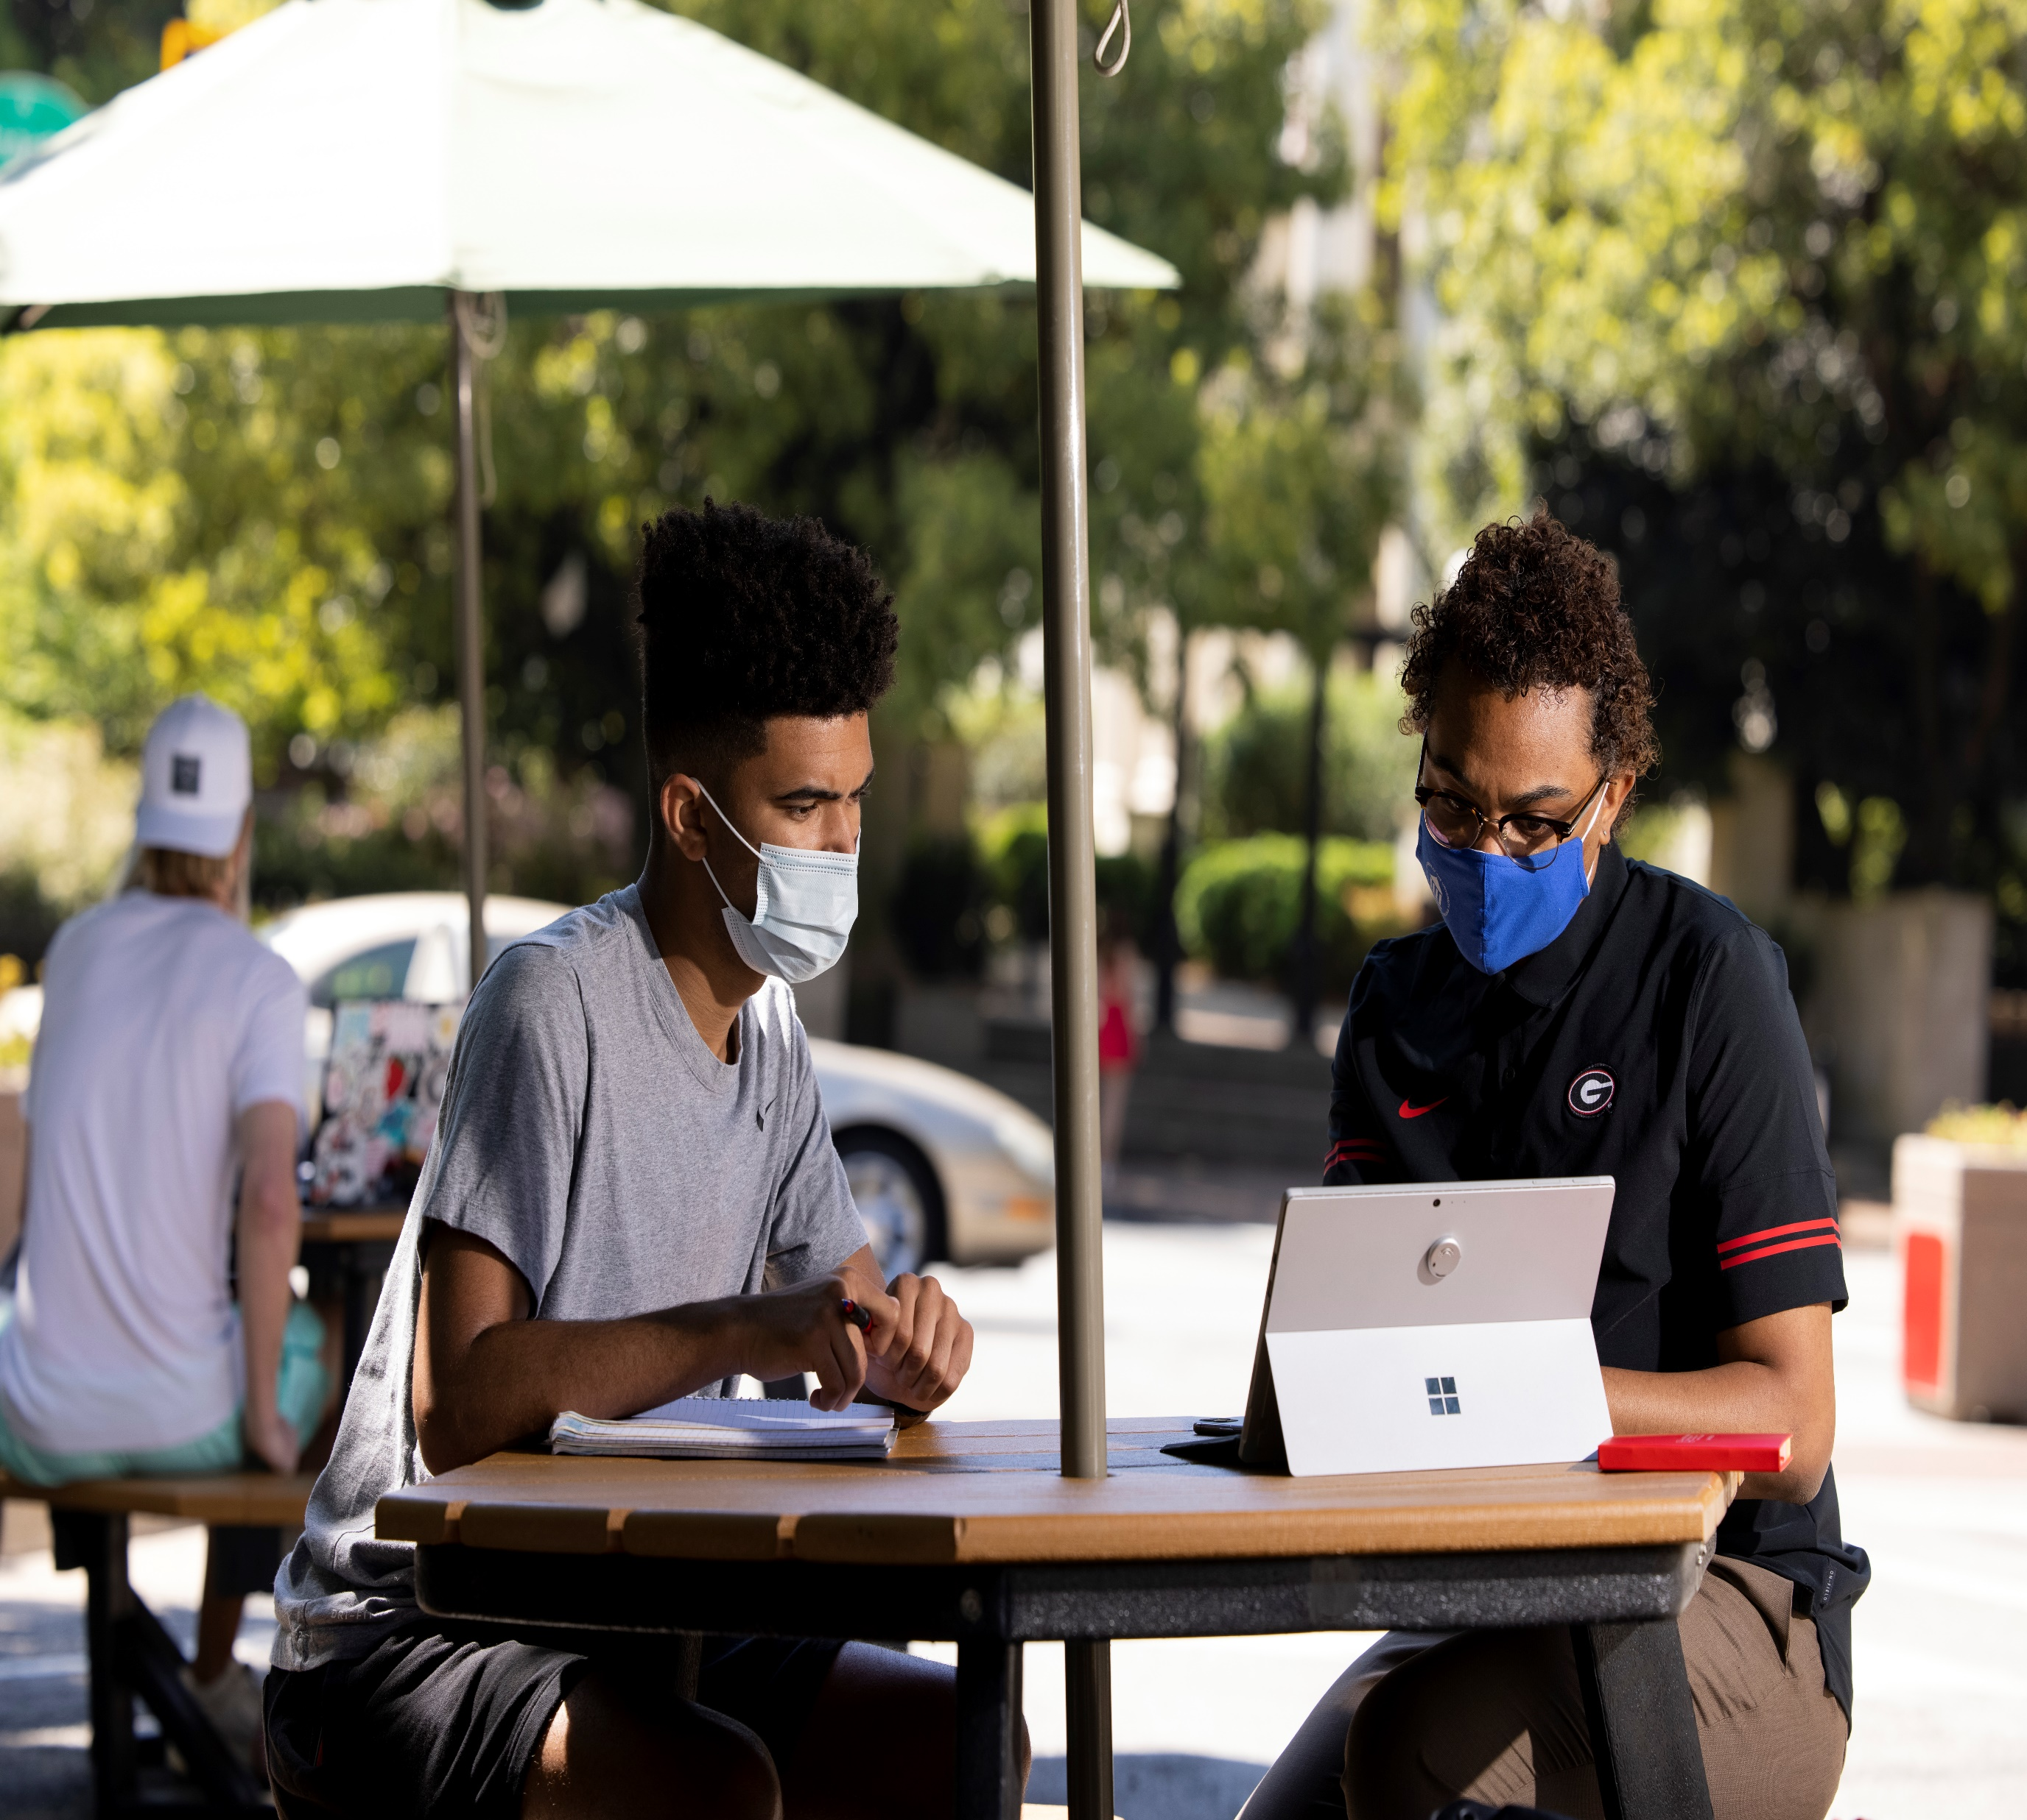
Strategic Partnerships

Slide 15
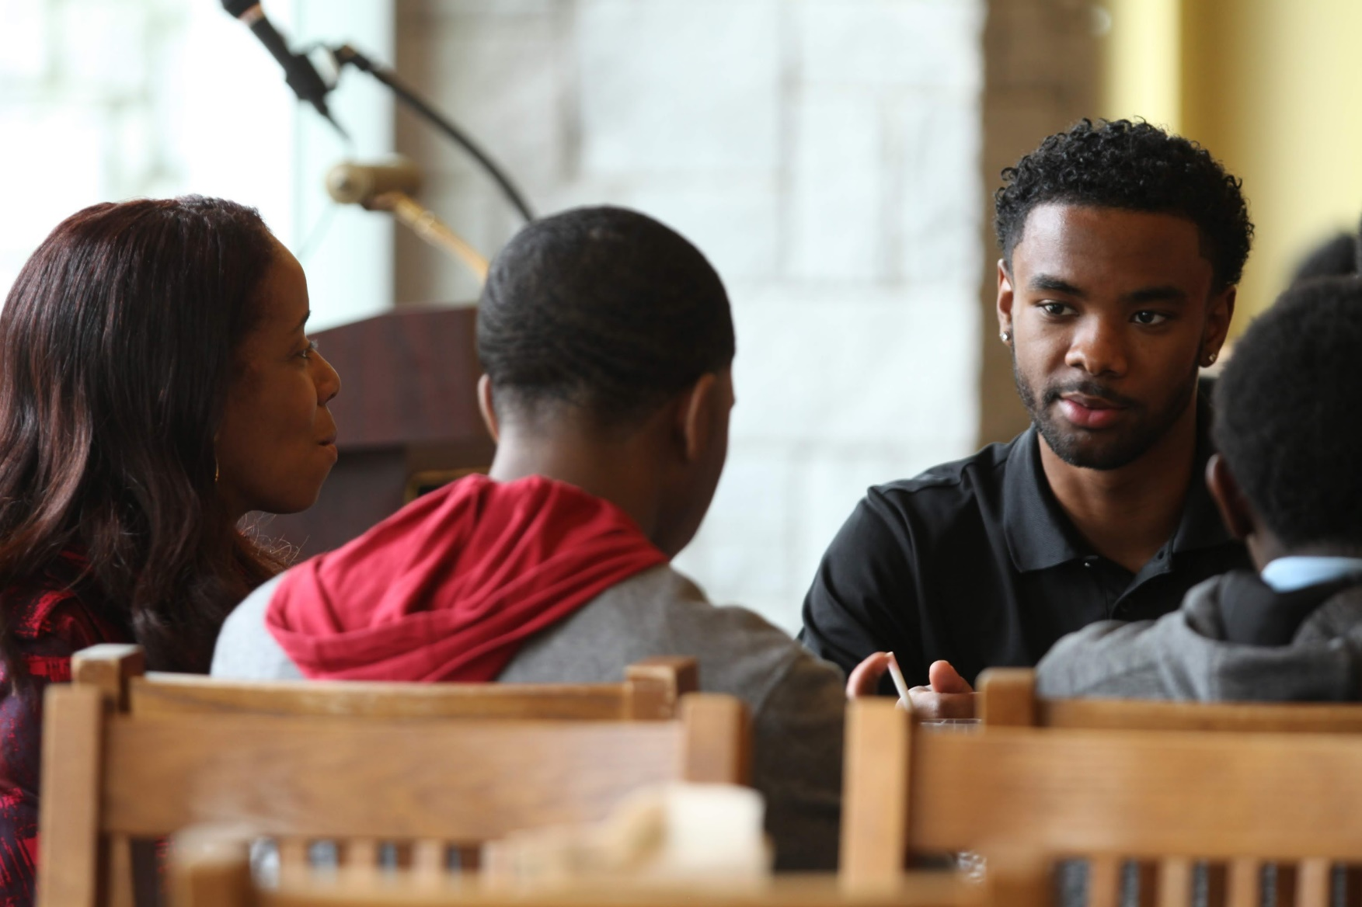
Exploratory Center
The Partnership Includes:
Spring Yield Program Session
Fall Introductory Email
Mid-Semester Intervention
Advising and Follow-up
Membership on Advisory Board

Slide 16
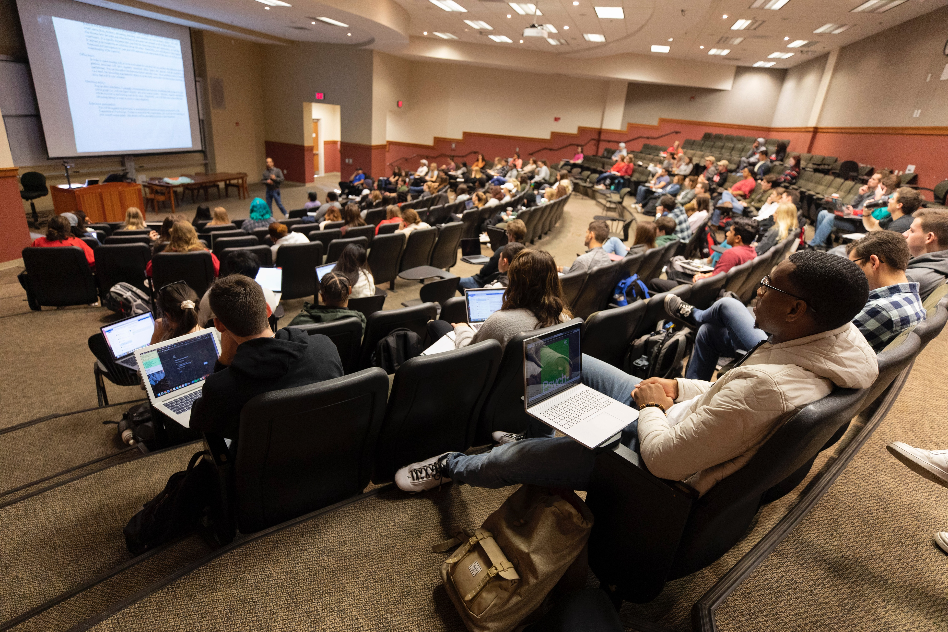
Academic Advising Services
The Partnership Includes:
Supplemental Academic Advising Support
Mid-Semester Intervention
Resource Guidance

Slide 17
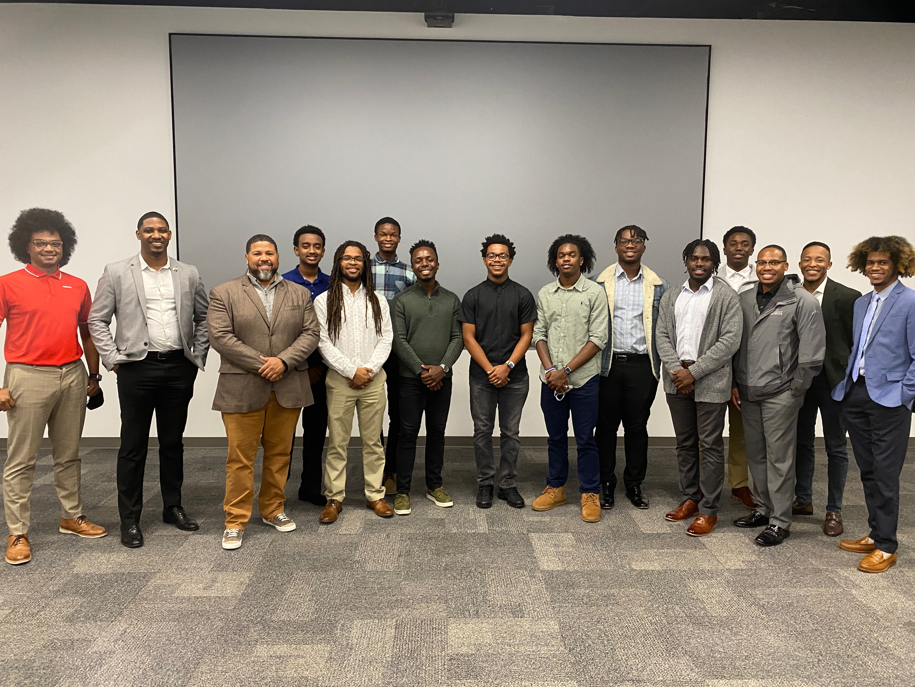
Division of Academic Enhancement
The Partnership Includes:
UNIV Courses for first-year, transfer,
and upper-class students

Slide 18

Through this partnership we anticipate that participants will benefit from:
Virtual Career Day
Career Pipeline Program
Connecting Students to Internships
Scholarship Opportunities
On-campus Engagement with Both the 100 Black Men and Emerging 100 Members
Mentorship with 100 Black Men and Emerging 100 Members

Slide 19
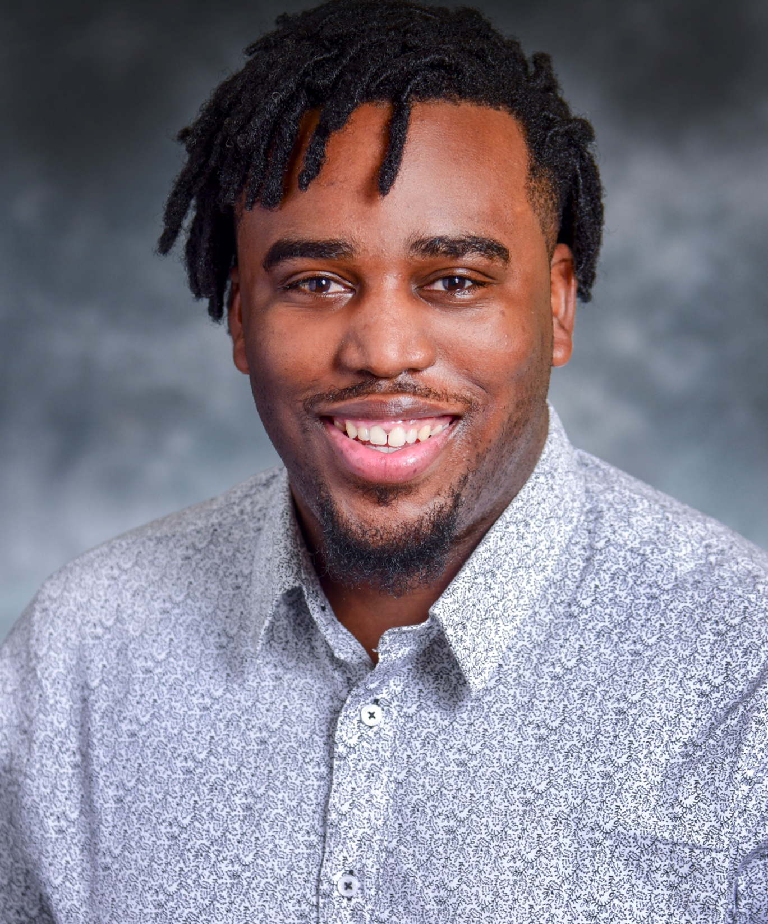

Mental Health & Wellbeing Support
Dr. Jesmond A. Fair
Clinical Psychologist
South Fulton County VA Clinic
Dr. Jesmond Fair is a University of Georgia Double Dawg and University of Alabama Alumnus from Opelika, AL. He currently serves as a clinical psychologist for the Atlanta VA and has a passion for the LGBTQ+, Black, and underserved communities.

Slide 20
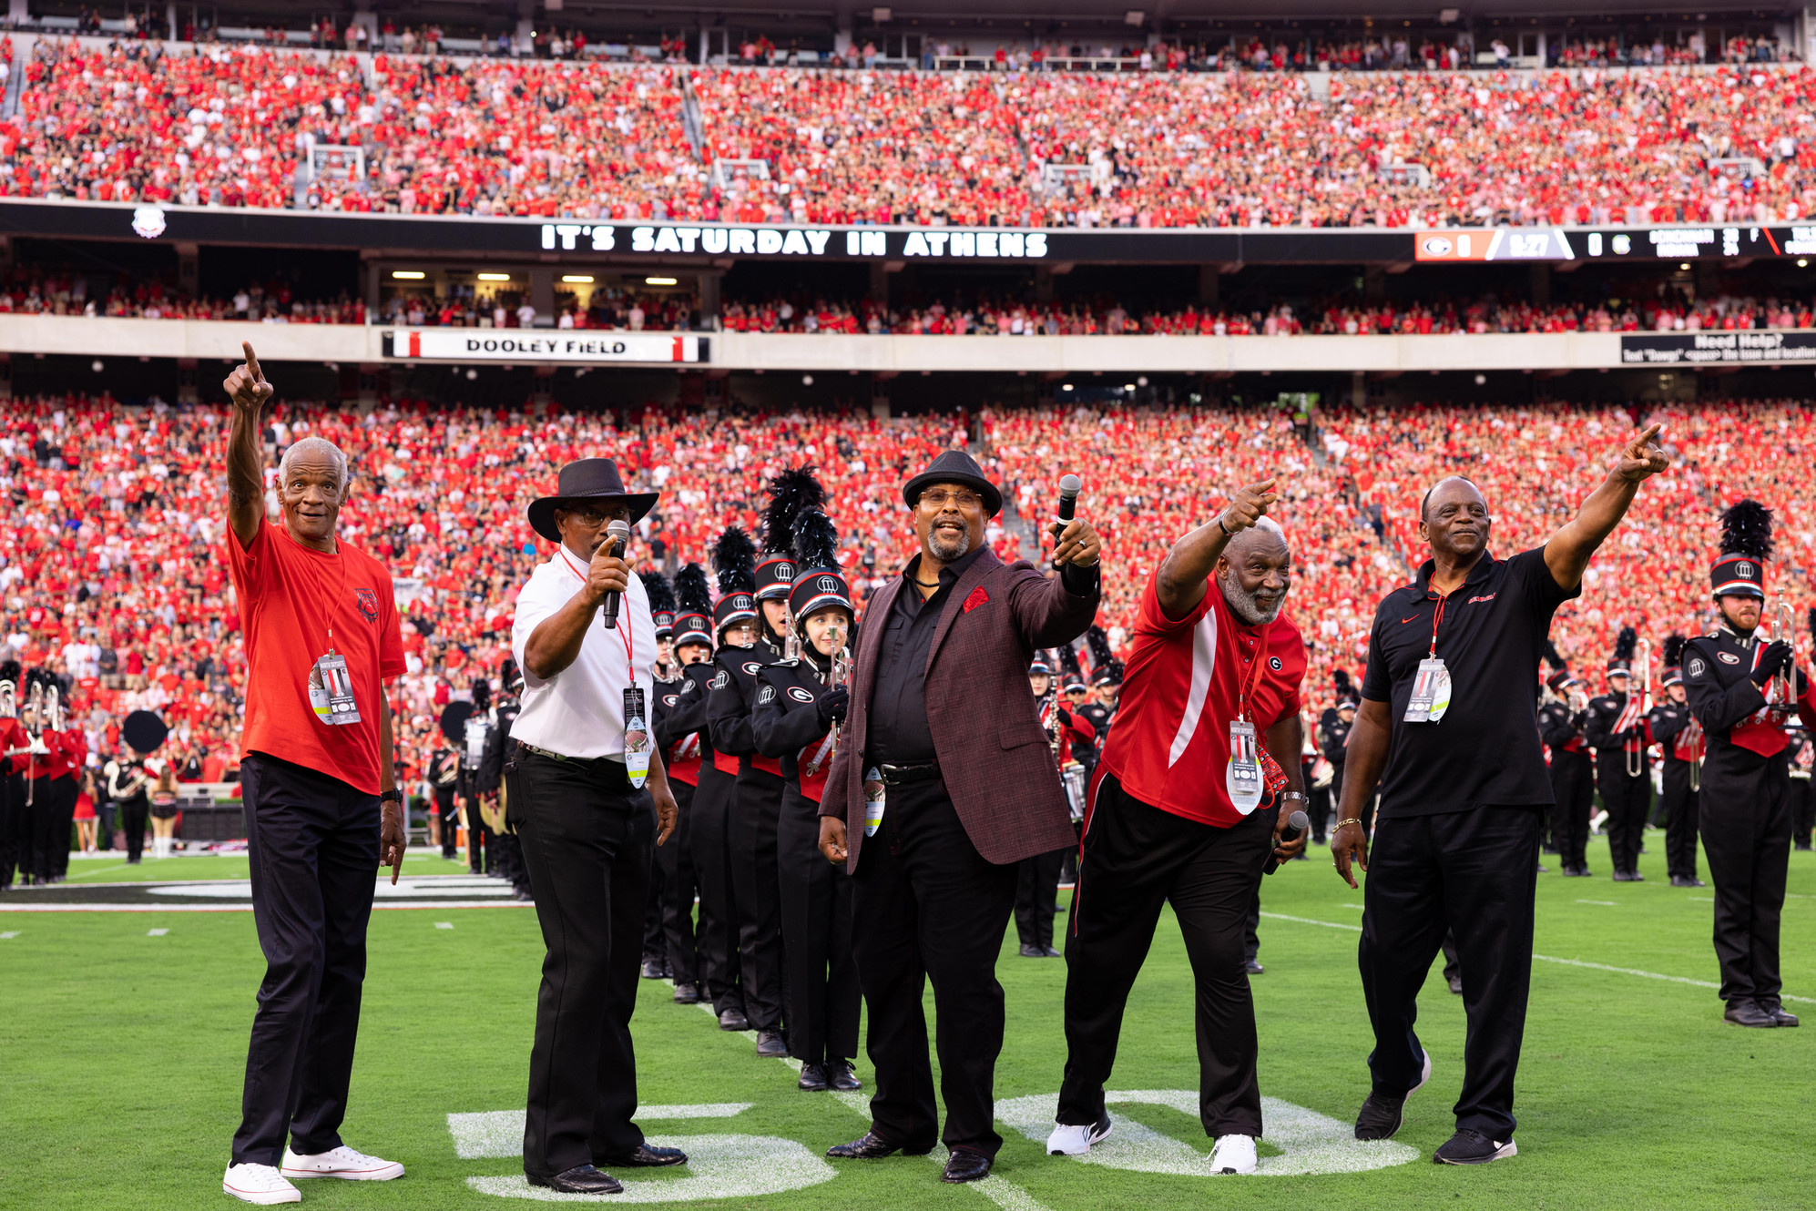
The Bulldogs Original Five
The first five African American football players to sign full scholarships in 1971 and play football at the University of Georgia
Their vision, "Lifting the gaze of young people to realize life beyond," encapsulates their mission to improve the lifetime success chances for youth, University of Georgia students, and student-athletes.
They leverage their unique place in UGA's athletic history, networks, and life experiences to guide these individuals toward successful careers beyond college.
As a program partner, they are committed to enhancing the effectiveness of GAAME’s pillars of success: academic empowerment, leadership cultivation, community support and advocacy, and experiential enrichment.
They will also support philanthropic efforts to raise vital funds to enhance the resources available to program participants.
Furthermore, they will utilize their network to provide career-benefitting experiences for GAAME/AAMI participants.

Slide 21
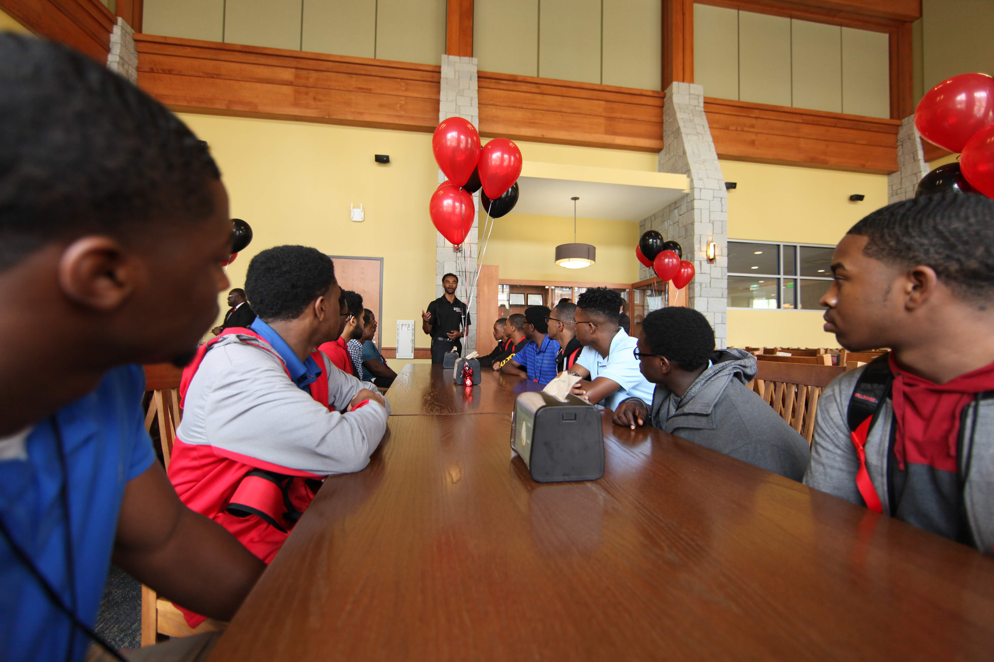
Upcoming Events
TBA

Slide 22


Slide 23
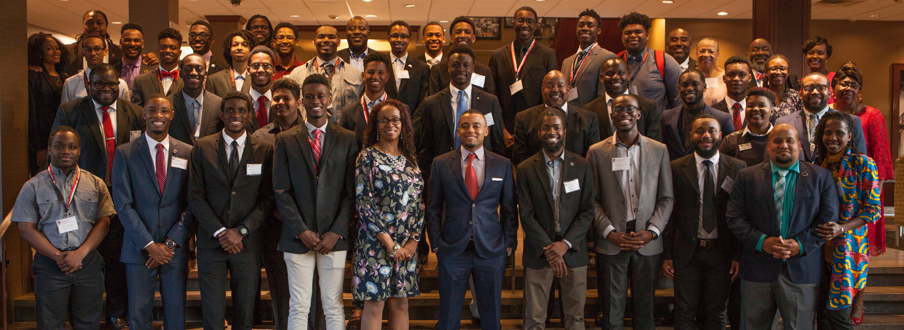
GAAME Weekend
Parent Orientation Faculty Lecture Lunch with the President
Ice Breakers Student Panel Intended Major Campus Visit
Leadership Dinner GAAME Night Lunch with Student Leaders
Graduate Student Panel Leadership Workshop Academic Opportunities Fair

Slide 24
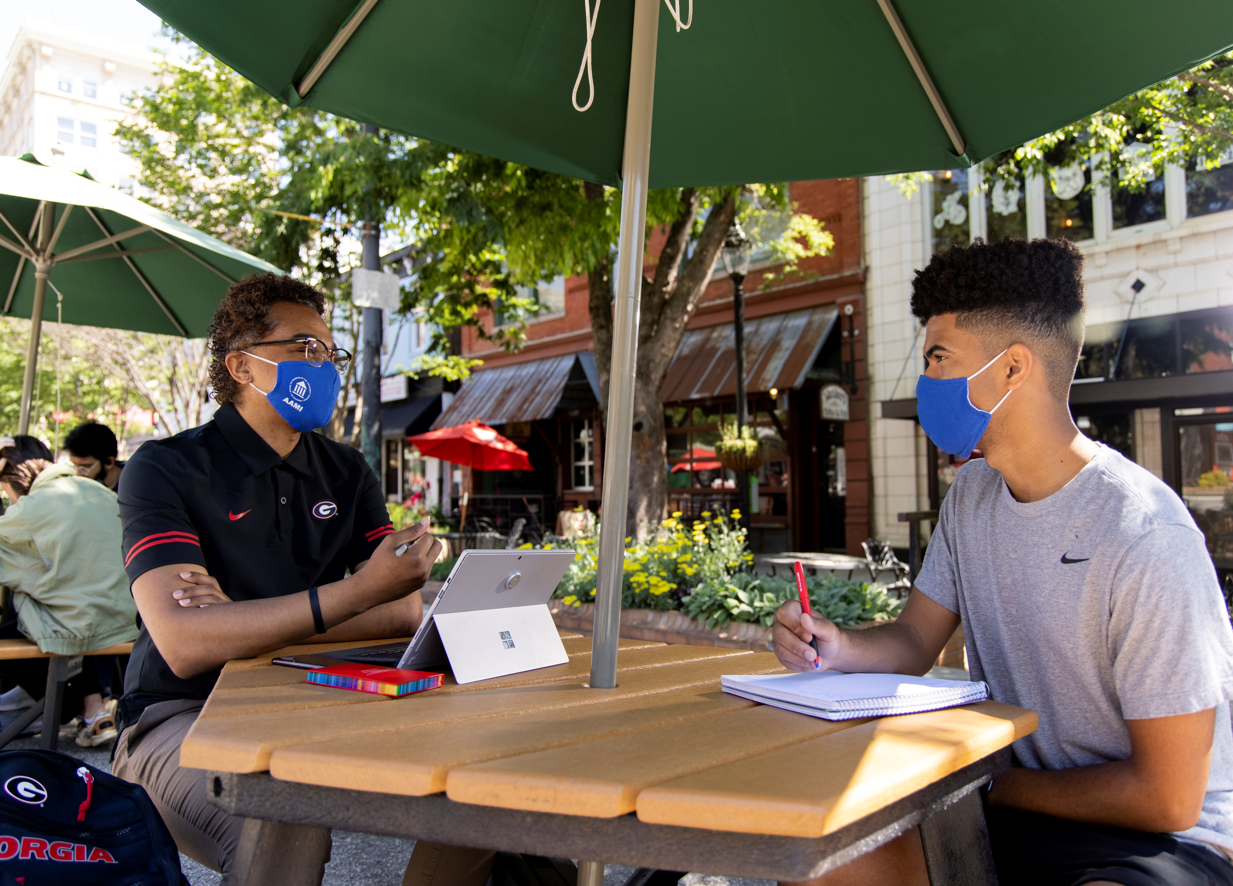
Contact Us

Slide 25
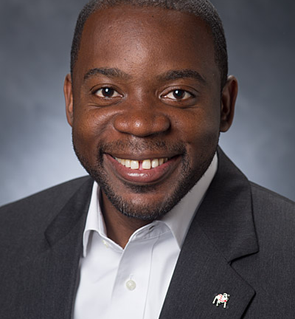
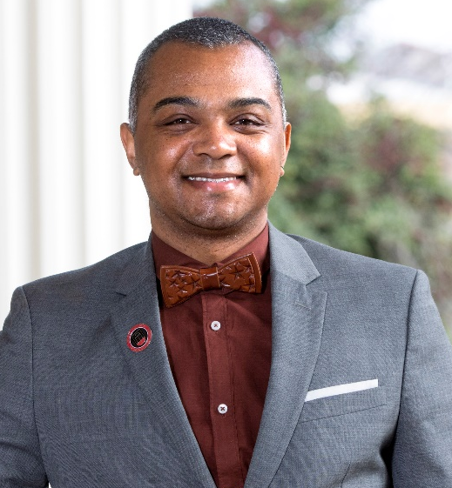
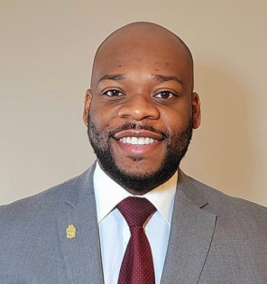
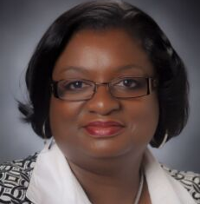
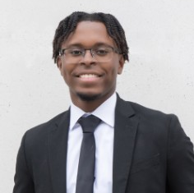
GAAME Staff
DR. DEMETRIUS SMITH
MARQUES DEXTER
OIE Interim Director/ AVP Student Affairs
Director
SmithD@uga.edu
mrdst3@uga.edu
JOAN PITTMAN
NICHOLAS CHANCY
Budget Manager
Program Coordinator
jpitt@uga.edu
GAAME@uga.edu
Office of Inclusive Excellence
Holmes-Hunter Academic Building
Athens, GA 30602
P: 706-583-8195
E: GAAME@uga.edu
https://oie.uga.edu/

Slide 26



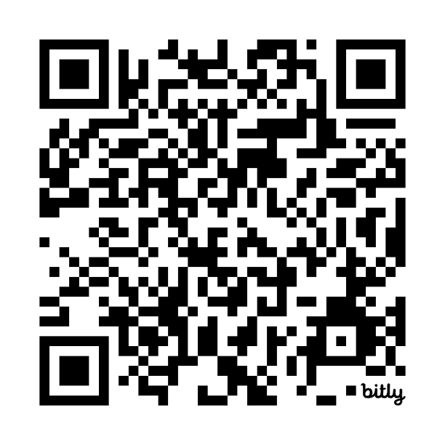
Are You GAAME?
Website
Application Form
Continuation Form
BMLS x GAAME First-Year Leadership Initiative Application
http://bit.ly/2UGA_GAAME
http://bit.ly/GAAMEScholarUGA
https://bit.ly/GAAMEScholarContinue
https://bit.ly/BMLS_GAAMEFYI24

